Slide 1


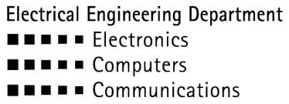

Machine Learning of a Piezoelectric Sensor for Detection of Children Abandoned in Cars
Presented by: Li Adar and Tom Beer
Supervised by: Alon Eilam
January 2017
Andrew and Erna Viterbi Faculty of Electrical Engineering
Signal and Image Processing Lab.

Slide 2
Motivation
In recent years, more and more children are left in the car by their parents or caretakers
This increasing phenomenon has even been given a name: ‘Forgotten Baby Syndrome” (FBS)
In Israel, 19 children have died in 400 such cases, in the last 8 years only

Slide 3
Project Goals
Develop a machine learning algorithm to detect cases of children forgotten in cars
Implement the algorithm on a real time microcontroller
Make use of a single piezoelectric sensor

Slide 4
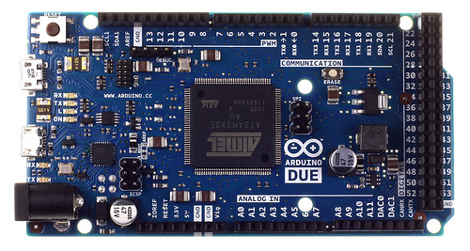
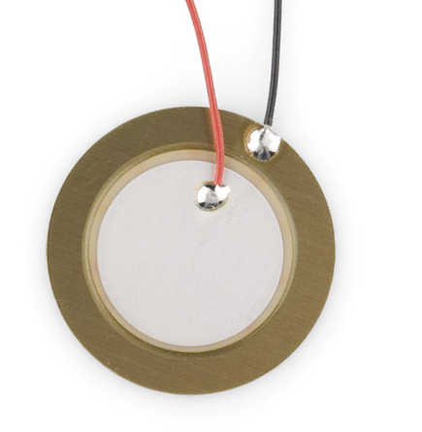
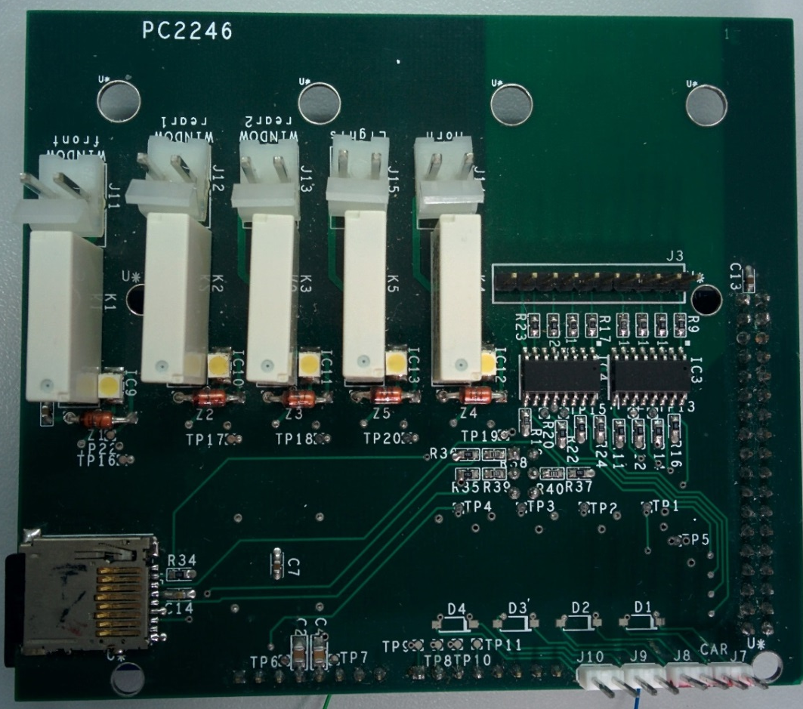
System Hardware
Piezoelectric sensors
Arduino DUE microcontroller
Interface board (microcontroller
to car and sensors)

Slide 5
Data Capture
Sensor data is recorded while driving
Signals are sampled at 1KHz
Buffer size is 4096 samples, with 50% overlap
Processing interval is of 2 seconds, resulting in ‘kid in’ or ‘no kid’ decision taken at the end of each interval
While in training, the data is tagged ‘kid in’ or ‘no kid’ according to case

Slide 6
Prior Art: Two Sensors
Two sensors are used, one for child ballistocardiography and the other for reference
Using Fourier analysis, spectral content of both sensors is compared
If energy ratio of relevant frequencies between child sensor and reference sensor exceeds a predefined threshold, the system declares a child in the car
Down side
Complicated installation: the system is non-standalone, and cannot be delivered as an integrated unit
Notes:
Threshold = 4

Slide 7
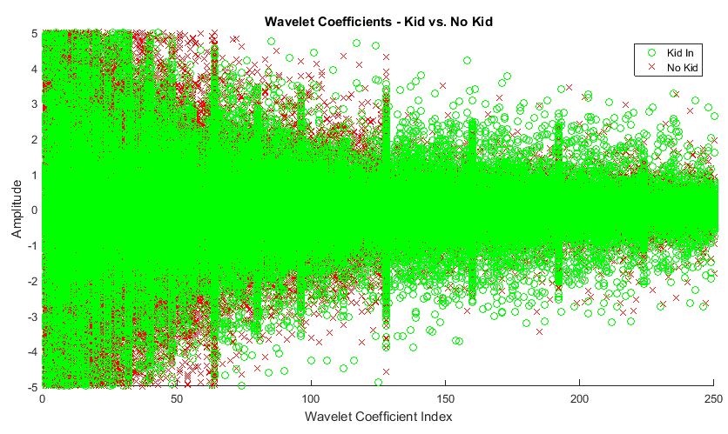
Machine Learning based decision
If a decision can be made using a single sensor without degrading performance, practical feasibility will be improved
We aspire not only to maintain the current performance, but to improve it significantly
Stages of a machine learning based decision:
Signal features extraction
Classification

Slide 8
Machine learning: First attempt
Input features were selected to be 250 first coefficients of a Daubechies-4 wavelet transform
Classification algorithm was chosen to be Linear Discriminant Analysis (LDA)
Simulation and training of the parameters is done in Matlab
Classifier is implemented on the microcontroller

Slide 9


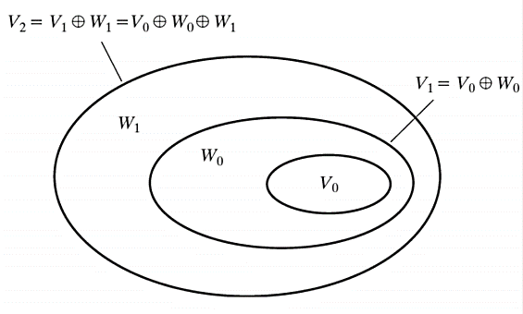


Wavelet Transform (1)
Allows multi resolution analysis
A set of wavelet functions Ψ and a scaling functions φ are defined by dyadic translations and dilations:
Subspaces of Ψ and φ are orthogonal to one another.
Higher order subspaces of φ and Ψ are nested in lower order subspaces of φ and Ψ , respectively:

Slide 10
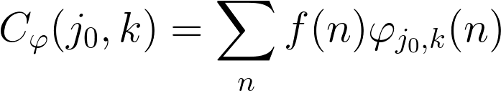
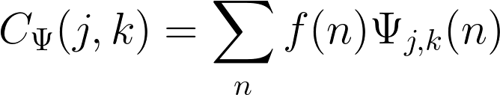
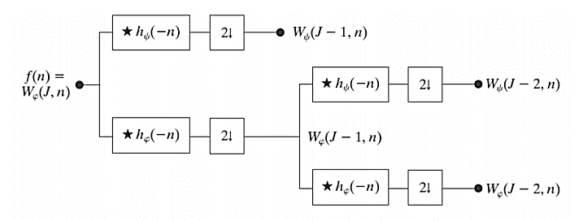
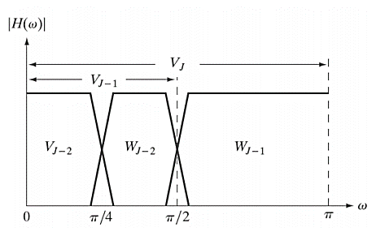
Wavelet Transform (2)
Discrete wavelet transform (DWT) is defined by:

Slide 11


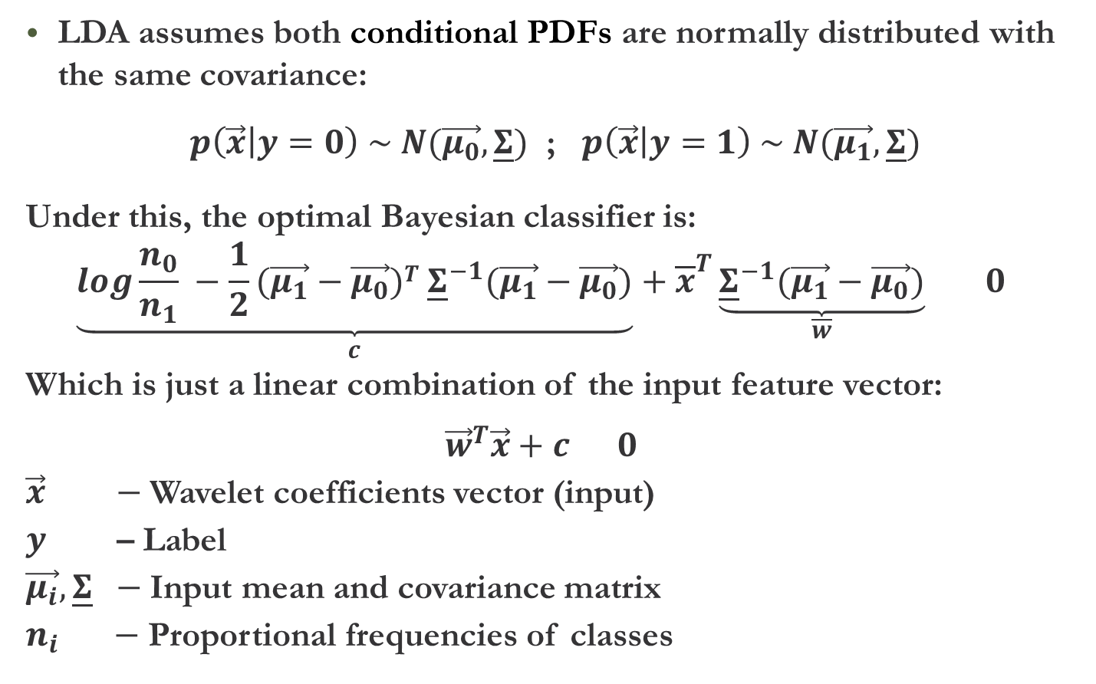
Linear Discriminant Analysis
LDA assumes both conditional PDFs are normally distributed with the same covariance:
$p\left(\vec{x} | y=0\right) \sim N(\vec{μ_{0}},\underline{Σ})$ ; $p\left(\vec{x} | y=1\right) \sim N(\vec{μ_{1}},\underline{Σ})$
Under this, the optimal Bayesian classifier is:
$$\underset{c}{\underbrace{log\frac{n_{0}}{n_{1}} −\frac{1}{2}(\vec{μ_{1}}−\vec{μ_{0}})T {\underline{Σ}}^{−1}(\vec{μ_{1}}−\vec{μ_{0}})}}+{\overline{x}}^{T}\underset{\overline{w}}{\underbrace{{\underline{Σ}}^{−1}(\vec{μ_{1}}−\vec{μ_{0}})}} 0$$
Which is just a linear combination of the input feature vector:
$${\vec{w}}^{T}\vec{x}+c 0$$
$\vec{x} −$Wavelet coefficients vector (input)
$y$ – Label
$\vec{μ_{i}},\underline{Σ} −$Input mean and covariance matrix
$n_{i} −$ Proportional frequencies of classes

Slide 12
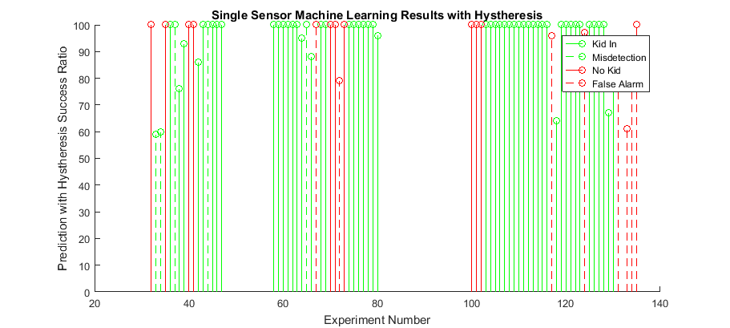
Performance
11% false alarms and 7% miss detections out of 74 experiments
Unsatisfactory results, but may improve with more data

Slide 13
Progress (1)
Learn to code in Arduino development environment
Implement wavelet transform in Arduino
Implement LDA classifier in Arduino
Implement an SD interface to allow simulation on signals independently of sensors

Slide 14
Progress (2)
Real-time computation measurements were made in order to make sure the 2 seconds time limit is held:
Current code uses ~18% of the given timeframe, so there’s still extra room for later extensions
Full compatibility with Matlab simulation– almost there!

Slide 15
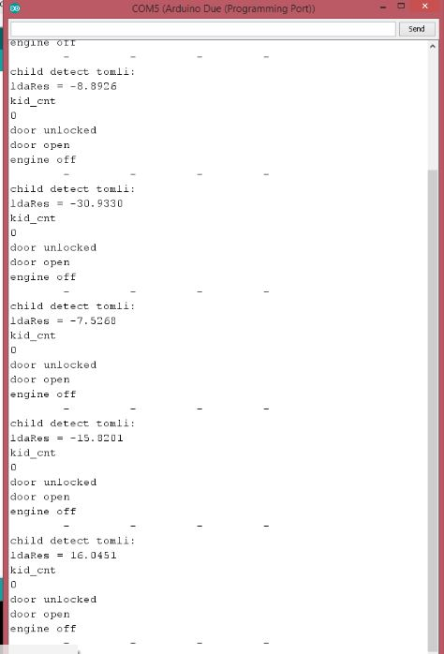
Live Demo

Slide 16
What’s Next
Our goal is to maximize the system’s success rate
How?
Receive more data
Examine more classification algorithms to improve the decision rule
Consider replacing or adding more input features (e.g signal energy)
Implement the selected classifier and input transform
in Arduino
Notes:
Possible approaches: waiting for Yair

Slide 17
Summary
Significant progress was made with the first machine learning classifier - still in process
After achieving full compatibility, we’ll examine more classification models
The selected model will be implemented on the firmware
More data is urgently needed for performance analysis and parameter tuning

Slide 18
Thank you

